Slide 1
Heart Health Analysis
Machine Learning Project
Presented by:
Roll number :102316118 Name :Vansh Rattan
Roll number :102316123 Name :Aryan Sood
Faculty Name:
Dr. Nitin Arora

Slide 2
Content
Introduction
Objectives
Methodology
Working Model
Results
Conclusion
References

Slide 3

Introduction
Technical Concepts: Utilizing Supervised Machine Learning to classify patient risk factors using algorithms like Random Forest and Logistic Regression.
Motivation: Cardiovascular diseases are the leading cause of death globally. Early detection can significantly reduce mortality.
Problem Statement: Traditional diagnosis is time-consuming. We aim to automate risk prediction based on physiological attributes.
Dataset Features: Age, BMI, Glucose, Marital Status, Smoking, Gender, Hypertension, Heart Disease History, Residence.

Slide 4
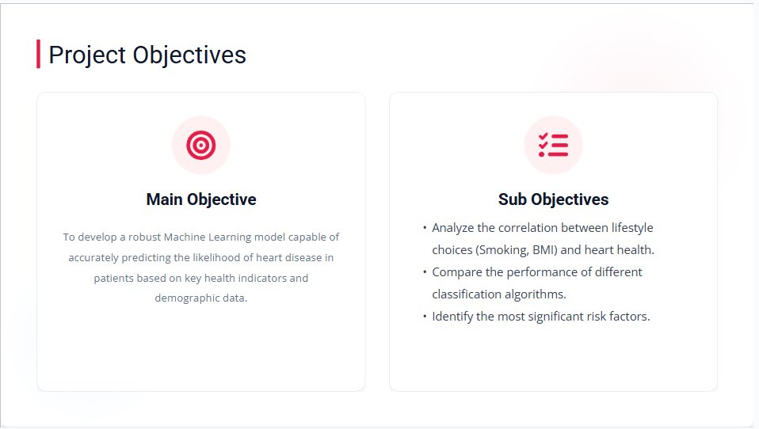
Objective
Main Objective
Sub Objective

Slide 5
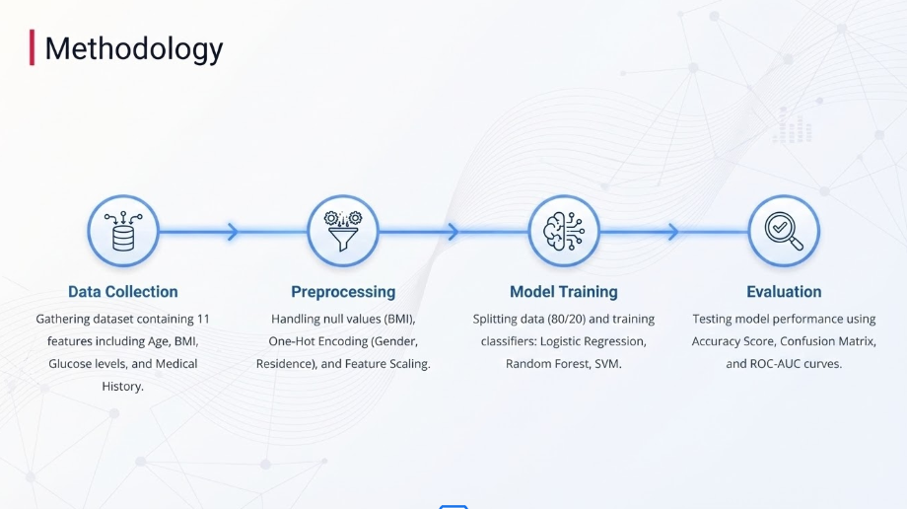

Slide 6
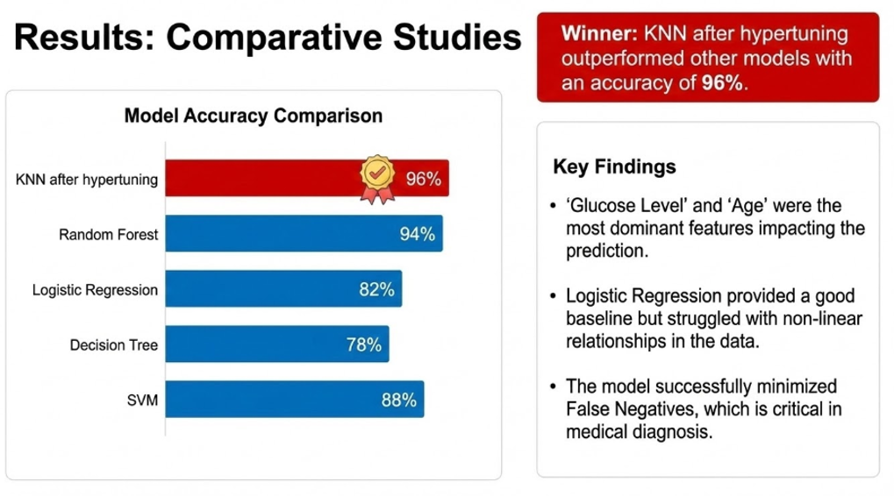

Slide 7
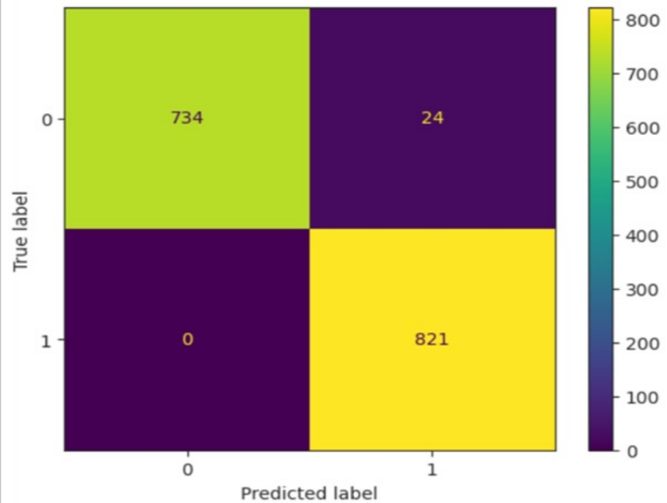
Result
Test Cases & Confusion Matrix
Test Case 1:
Male, 55, Smoker, High Glucose → Predicted: High Risk
Test Case 2:
Female, 30, Non-smoker, Normal BMI → Predicted: Low Risk
The heatmap (right) visualizes the model’s performance.
High diagonal values indicate correct predictions for both ‘Disease’ and ‘No Disease’ classes.

Slide 8
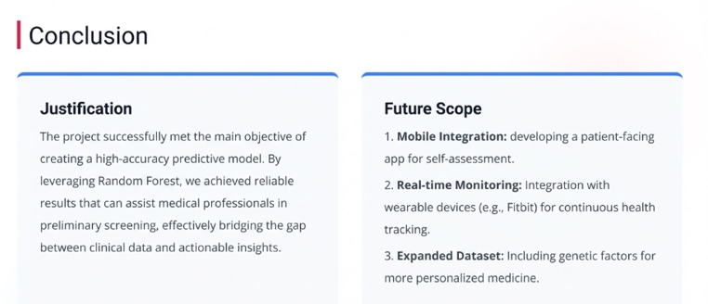
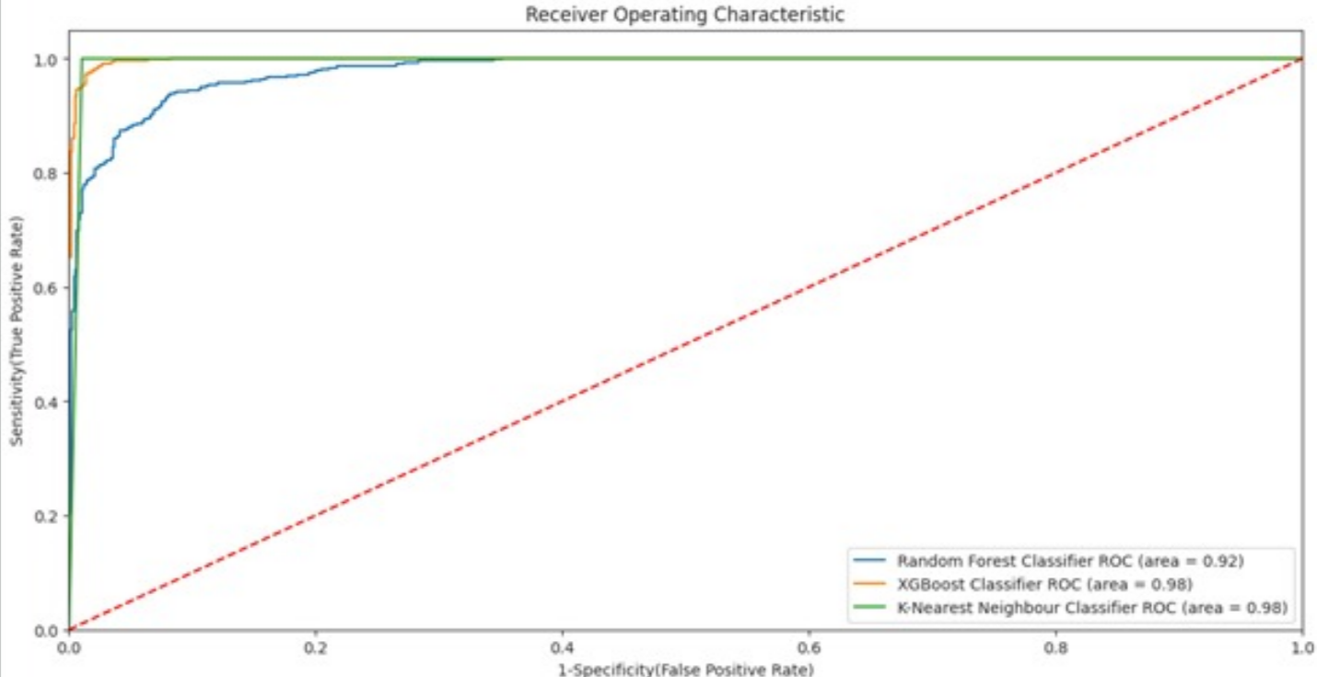

Slide 9
References
The graphs are made with the help of our dataset and graph tools.
Stroke Prediction Dataset (Kaggle): https://www.kaggle.com/datasets/fedesoriano/stroke- Referencesprediction-dataset
Scikit-Learn – Machine Learning Libraryhttps://scikit-learn.org/stable/
Flask – Python Backend Microframeworkhttps://flask.palletsprojects.com/

Slide 10

Thank You

